Slide 1
CHAPTER 2
Data Transmission media

Slide 2
Data Transmission Media
Data Transmission: The process of conveying data between two points by way of a communication medium.
A wide variety of media are available, but they fall into two classes;
  Bounded media: Confine the data to specific physical pathways.
    Common examples include copper wire and optical fiber cables.
  Unbounded media: Transmit the data-carrying signal through space, independent of a cable.
    Broadcast radio and television are examples of unbounded media.

Slide 3
Two Important Physical Limits of a Transmission System
Propagation delay
  Time required for signal to travel across media
  Example: electromagnetic radiation travels through space at the speed of light (c = 3×10⁸ meters per second)
Bandwidth
  Maximum times per second the signal can change

Slide 4
Characteristics to be considered when examining cables
Electrical magnetic interference (EMI):
  Many electrical devices generate magnetic fields that produce unwanted electrical currents in data cables.
  Common sources of EMI include Electrical motors, fluorescent lights etc.
Bandwidth: The range of frequencies that the cable can accommodate.
Attenuation: Signal strength reduces with distance.
  Electrical resistance contributes to this.
Cost: Depends on choice of cable

Slide 5
Forms of energy used to transmit data
Audible sounds
Electric current
Light
Omni-directional electromagnetic waves
  Radio Frequency (RF)
  Infrared
Directional electromagnetic waves
  Point-to-point satellite channel
  Limited broadcast (spot beam)
  Microwave
  Laser beam

Slide 6
Transmission Media
The transmission capacity depends on the distance and on whether the medium is point-to-point or multipoint
Two major classes
  Conducted/Guided/Bounded media
    Use a conductor such as a wire or a fiber optic cable to move the signal from sender to receiver.
  Wireless/Unguided/Unbounded media
    Use radio waves of different frequencies and do not need a wire or cable conductor to transmit signals.

Slide 7
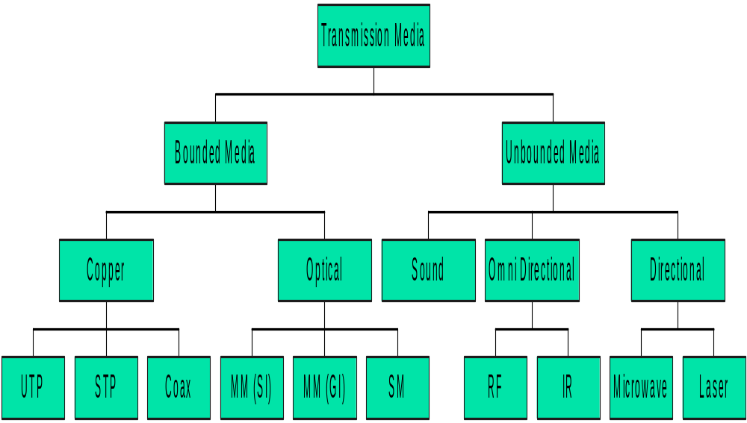
Transmission Media

Slide 8
Twisted Pair Wires
Consists of two insulated copper wires arranged in a regular spiral pattern to minimize the EMI between adjacent pairs
Often used at customer facilities and also over distances to carry voice as well as data communications
Low frequency transmission medium

Slide 9
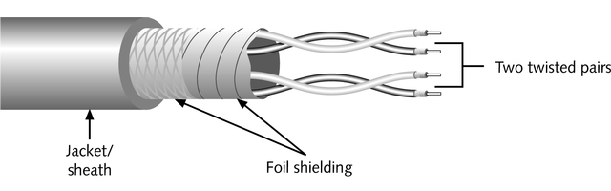
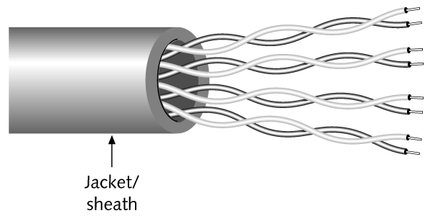
Twisted Pair Wires
Two varieties
  STP (shielded twisted pair)
    the pair is wrapped with metallic foil or braid to insulate the pair from electromagnetic interference
  UTP (unshielded twisted pair)
    Each wire is insulated with plastic wrap, but the pair is encased in an outer covering

Slide 10
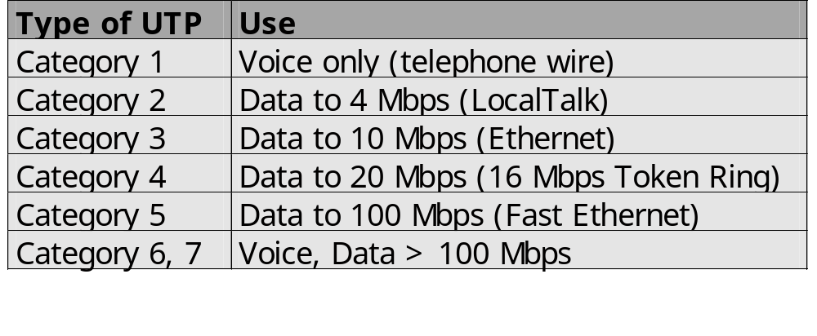
Twisted Pair
UTP cables come in a variety of grades, ranging from Cat 1(lowest quality) to Cat 7 (highest quality).
  When investigating the use of UTP cabling, determine the wire quality required for the network.

Slide 11
Twisted Pair Strengths and Weaknesses
Strengths
  Inexpensive and readily available
  Flexible and light weight
  Easy to work with and install
Weaknesses
  Susceptibility to EMI and noise
  Attenuation problem
  Relatively low bandwidth (3000Hz)
  STP is even more expensive, harder to work with

Slide 12
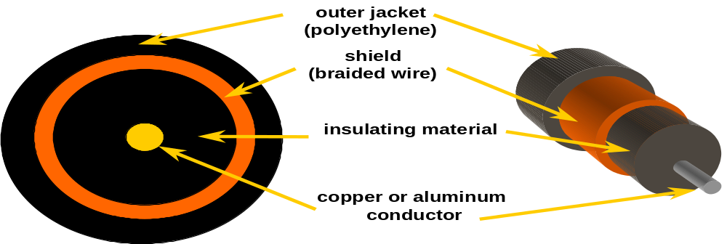
Coaxial Cable (or Coax)
Bandwidth of up to 400 MHz
Has an inner conductor surrounded by a braided mesh
Both conductors share a common center axial, hence the term “co-axial”

Slide 13
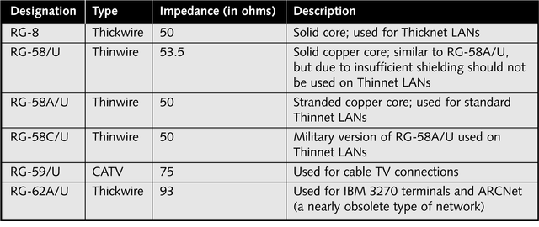
Coaxial Cables
Coax cable is terminated using the BNC (Bayonet Neill-Concelman) connectors

Slide 14
Coaxial Cables
The coaxial cable transmission media is used in two transmission methods
Baseband
  This has the following characteristics
    It transmits unmodulated digital signals
    Each cable carries a single channel
    The propagation of signals is bi-directional
    Stations are connected via T-connectors.
    There is no need for modems.

Slide 15
Coaxial cable
Broadband
  It has the following characteristics
    Digital signal modulated onto Radio Frequency (RF) carrier (analog)
    Channel allocation based on Frequency Division Multiplexing (FDM).
    Supports bi-directional transmission
    Stations are connected via RF modems.

Slide 16
Coax Strengths and Weaknesses
Strength
  Higher bandwidth
    400 to 600Mhz
    Up to 10,800 voice conversations
  Can be easily tapped (pros and cons)
Weaknesses
  Much less susceptible to interference than twisted pair
  High attenuation rate makes it expensive over long distance
  Bulky

Slide 17
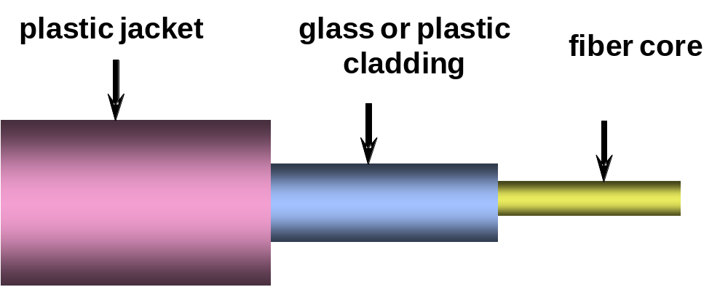
Fiber Optic Cable
Glass or plastic transmission medium
  used by telephone companies in place of long-distance trunk lines
  Also used in implementing local data communications networks
Consists of three concentric sections

Slide 18
Optical Fibers
The parts of the cable are as follows:
  The Light Conductor: A very fine fiber core.
    Glass is the most common material, allowing signals to be transmitted for several kilometers without being refreshed.
    Plastic is used in some circumstances, but plastic cables allow only short cable runs.
  The Cladding: A glass layer that surrounds the optical fiber core. (lower refractive index than the light conductor
    The optical characteristics of the cladding reflect light back to the core, ensuring that little of the light signal is lost.
  An outer Jacket: Protects the cable from damage.
    A single jacket can be used to bundle multiple core/cladding fibers into a multi-fiber cable.

Slide 19
Optical Fibers
The light signals on fiber optic cables are generated either by
  light emitting diodes (LEDs) or by injection laser diodes (ILDs),
ILDs are similar to LEDs but produce laser light.
  The purity of laser light is desirable, increasing both data rates and transmission distance.
Light emitting diode (LED) or laser injects light into fiber. The light rays in the glass are totally reflected inside the core of FO has to have higher refractive index than cladding and also angle of incidence of light ray is greater than critical angle for core and its cladding.
Signals are received by Photodiodes, solid state devices that detect variations in light intensity.

Slide 20
Fiber Optic Types
Multimode step-index fiber
  The reflective walls of the fiber move the light pulses to the receiver.
  Common MM core sizes are 50 µm and 62.5 µm.
Multimode graded-index fiber
  Acts to refract the light toward the center of the fiber by variations in the density
Single mode fiber
  The light is guided down the center of an extremely narrow core.
  The core size is typically 8.3 µm.

Slide 21
Fiber Optic Signals
fiber optic multimode
step-index
fiber optic multimode
graded-index
fiber optic single mode

Slide 22
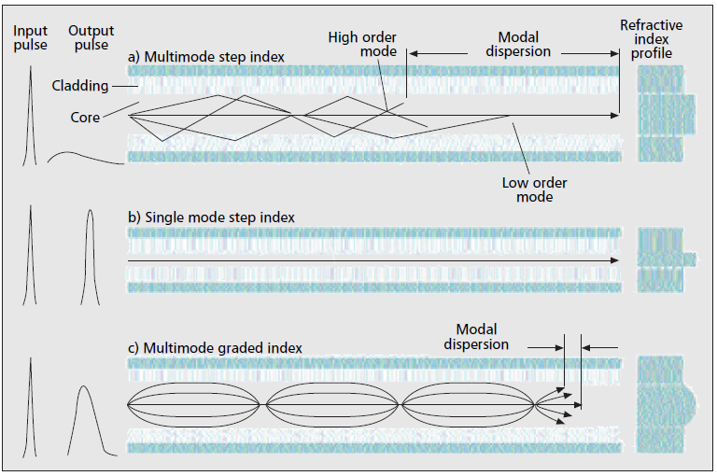
Fiber Optic Signals

Slide 23
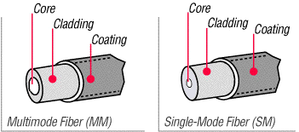
Types of Optical Fibers

Slide 24
Basic Optical Fibre Communication System
An Optical Fiber Communication System consists of
Transmitter
  Optical source (LED or Laser diode) + driver circuit
Optical Fibre
  Single mode fibre, or
  Multimode fibre
Receiver
  Photodetector PIN or APD + receiver circuit

Slide 25
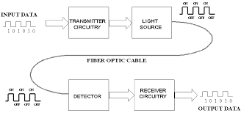
Basic Optical Fibre Communication System

Slide 26



Basic Optical Fibre Communication System

Slide 27
Fiber Optic Advantages
Greater capacity (bandwidth of up to 2 Gbps)
Smaller size and lighter weight
Lower attenuation(fewer repeaters due to low attenuation of fibers)
Immunity to environmental interference
Highly secure due to tap difficulty and lack of signal radiation
Long lengths; Long, continuous lengths also provide advantages for installers and end-users.

Slide 28
Fiber Optic Disadvantages
Expensive over short distance
Requires highly skilled installers
Adding additional nodes is relatively difficult
Special devices are required to convert light signals into data or voice and vice versa.

Slide 29
Wireless (Unguided Media) Transmission
Transmission and reception are achieved by means of an antenna
Directional
  Transmitting antenna produce a focused beam
  Transmitter and receiver must be aligned
Omni directional
  Signal spreads out in all directions
  Can be received by many antennas

Slide 30
Radio wave propagation Modes
Ground-wave propagation
Sky-wave propagation
Line-of-sight propagation

Slide 31
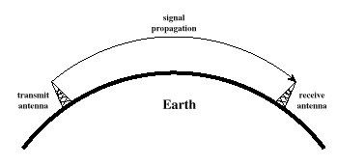
Ground Wave Propagation
Follows contour of the earth
Can Propagate considerable distances
Frequencies up to 2 MHz
Example; AM radio

Slide 32
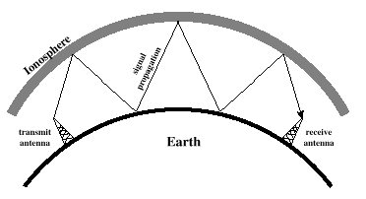
Sky Wave Propagation
Signal reflected from ionized layer of atmosphere back down to earth
Signal can travel a number of hops, back and forth between ionosphere and earth’s surface
Reflection effect is caused by refraction

Slide 33
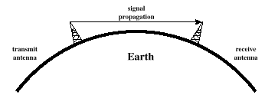
Line-of-Sight Propagation
Transmitting and receiving antennas must be within line of sight
  Satellite communication – signal above 30 MHz not reflected by ionosphere
  Ground communication – antennas within effective line of site due to refraction
Refraction – bending of microwaves by the atmosphere
  Velocity of electromagnetic wave is a function of the density of the medium

Slide 34
Impairments and Capacity
Impairments exist in all forms of data transmission
Analog signal impairments result in random modifications that impair signal quality
Digital signal impairments result in bit errors (1s and 0s transposed)

Slide 35
Transmission Impairments
Attenuation
  loss of signal strength over distance
Phase Distortion
  Clipping or change in shape of waveform of a signal
Delay Distortion
  Signals arrive at receiver at different times due to different speeds for different frequencies
Noise- signal that tends to interfere with desired signal
Notes:
6

Slide 36
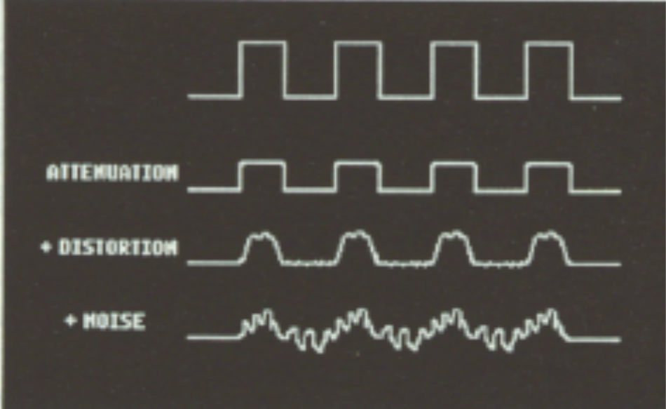
Degradation of signals

Slide 37
LOS Wireless Transmission Impairments
Attenuation and attenuation distortion
Free space loss
Atmospheric absorption
Multipath
Refraction
Noise

Slide 38
Attenuation
Strength of signal falls off with distance over transmission medium
Attenuation factors for unguided media:
  Received signal must have sufficient strength so that circuitry in the receiver can interpret the signal
  Signal must maintain a level sufficiently higher than noise to be received without error
  Attenuation is greater at higher frequencies, causing distortion

Slide 39
Categories of Noise
1. Thermal Noise 2. Intermodulation noise 3. Crosstalk 4. Impulse Noise
Thermal Noise/ white noise
Thermal noise is due to agitation of electrons
Present in all electronic devices and transmission media
Cannot be eliminated
Function of temperature
Particularly significant for satellite communication

Slide 40
Categories of Noise
Intermodulation noise – occurs if signals with different frequencies share the same medium
  Interference caused by a signal produced at a frequency that is the sum or difference of original frequencies
Crosstalk – unwanted coupling between signal paths, very common in twisted pair cables.
Impulse noise – irregular pulses or noise spikes
  Short duration and of relatively high amplitude
  Caused by external electromagnetic disturbances, or faults and flaws in the communications system

Slide 41
Other Impairments
Atmospheric absorption – water vapor and oxygen contribute to attenuation
Multipath – obstacles reflect signals so that multiple copies with varying delays are received
Refraction – bending of radio waves as they propagate through the atmosphere

Slide 42
Error Compensation Mechanisms
1. Forward error correction
Transmitter adds error-correcting code to data block
  Code is a function of the data bits
Receiver calculates error-correcting code from incoming data bits
  If calculated code matches incoming code, no error occurred
  If error-correcting codes don’t match, receiver attempts to determine bits in error and correct
2. Adaptive equalization
Can be applied to transmissions that carry analog or digital information
  Analog voice or video
  Digital data, digitized voice or video
Used to combat inter-symbol interference
Involves gathering dispersed symbol energy back into its original time interval

Slide 43
Error Compensation Mechanisms
3. Diversity techniques
Diversity is based on the fact that individual channels experience independent fading events
Space diversity – techniques involving physical transmission path
Frequency diversity – techniques where the signal is spread out over a larger frequency bandwidth or carried on multiple frequency carriers
Time diversity – techniques aimed at spreading the data out over time

Slide 44
Wireless Examples
Terrestrial microwave transmission
Satellite transmission
Broadcast radio
Infrared

Slide 45
Terrestrial Microwave Transmission
Uses the radio frequency spectrum, commonly from 2 to 40 Ghz
Transmitter is a parabolic dish, mounted as high as possible
Used by common carriers as well as by private networks
Requires unobstructed line-of-sight between source and receiver
Curvature of the earth requires stations (called repeaters) to be ~30 miles apart

Slide 46
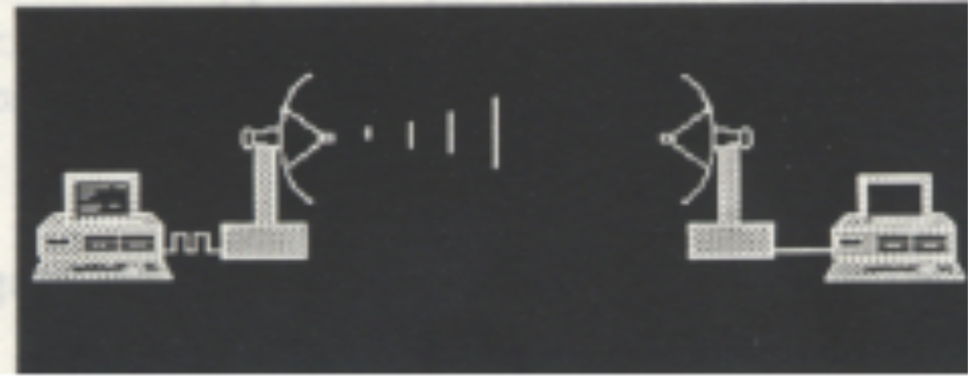
Microwave Transmission Applications
Long-haul telecommunications service for both voice and television transmission
Short point-to-point links between buildings for closed-circuit TV or a data link between LANs

Slide 47
Microwave Transmission Strengths and Weaknesses
Advantages
  No cabling needed between sites
  Wide bandwidth
  Multi-channel transmissions
Disadvantages
  Line-of-sight requirement
  Expensive towers and repeaters
  Subject to interference such as passing airplanes and rain

Slide 48
Satellite Microwave Transmission
A microwave relay station in space
Can relay signals over long distances
Geostationary satellites
  Remain above the equator at a height of 22,300 miles (geosynchronous orbit)
  Travel around the earth in exactly the time the earth takes to rotate

Slide 49
Satellite Transmission Links
Earth stations communicate by sending signals to the satellite on an uplink
The satellite then repeats those signals on a downlink
The broadcast nature of the downlink makes it attractive for services such as the distribution of television programming

Slide 50
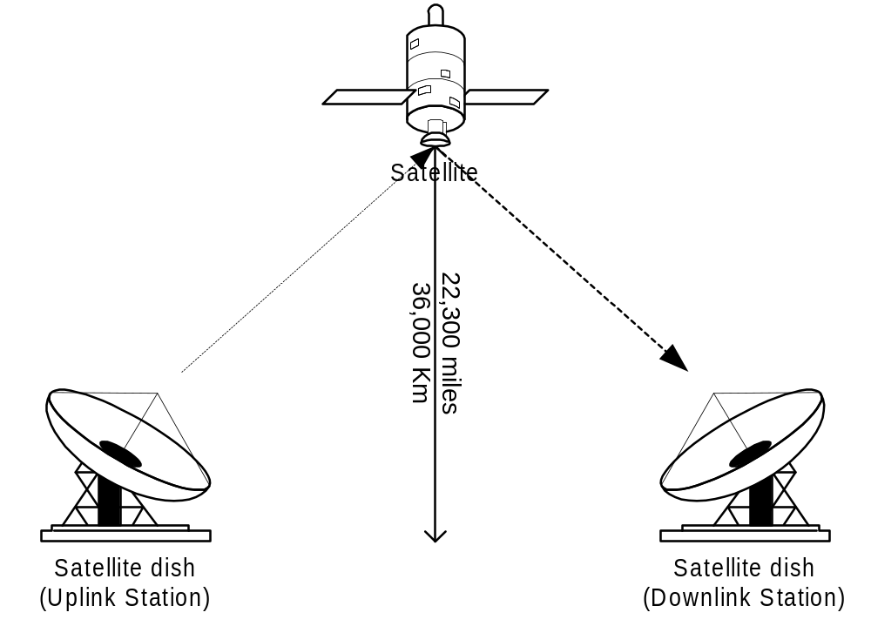
Satellite Transmission Process

Slide 51
Satellite Transmission Applications
Television distribution
  A network provides programming from a central location
  Direct broadcast satellite (DBS)
Long-distance telephone transmission
  High-usage international trunks
Private business networks

Slide 52
Principal Satellite Transmission Bands
C band: 4(downlink) - 6(uplink) GHz
  the first to be designated uses large dishes
Ku band: 12(downlink) -14(uplink) GHz
  Uses smaller dishes. Rain interference is the major problem
Ka band: 19(downlink) - 29(uplink) GHz
  equipment needed to use the band is still very expensive

Slide 53
Satellite Advantages and Disadvantages
Advantages
  Can reach a large geographical area
  High bandwidth
  Cheaper over long distances
Disadvantages
  High initial cost
  Susceptible to noise and interference
  Propagation delay

Slide 54
Common Carriers
A government-regulated private company
Involved in the sale of infrastructure services in transportation and communications
Required to serve all clients indiscriminately
Services and prices from common carriers are described in tariffs

Slide 55
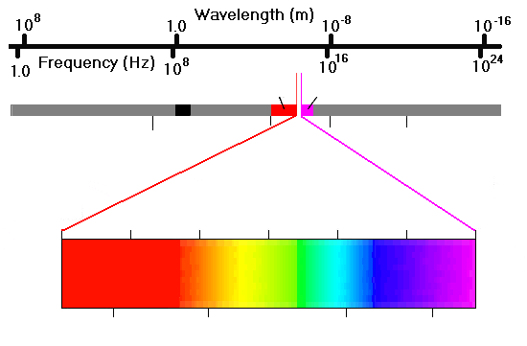
The Electromagnetic Spectrum
TV, FM
Infrared
Ultraviolet
Long radio waves
Microwaves
X-rays
Gamma rays
700 nm
600 nm
500 nm
400 nm
4.5x10¹⁴ Hz
5x10¹⁴ Hz
6x10¹⁴ Hz
7x10¹⁴ Hz

Slide 56
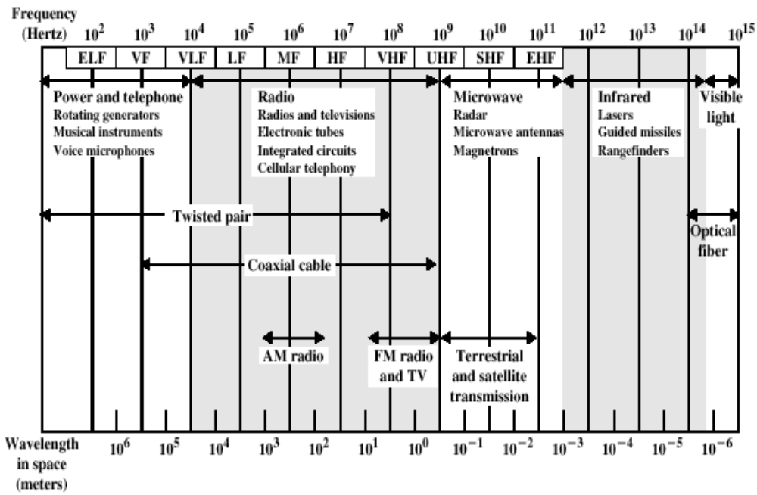
Electromagnetic Spectrum for Transmission Medium

